Slide 1
Concurrency and Synchronization
Chapter 5
Last Updated 2/7/2018 12:46 PM

Slide 2
Principles of Concurrency
Multiprocessing opens up the issues of interleaved and overlapping execution of multiple processes or threads.
A multiprocessor (SMP) permits the interleaving and overlapping execution of multiple instruction traces.
A uniprocessor (single) is restricted to the interleaving of execution of multiple process (thread) instruction traces.
This section describes issues applicable to both interleaving and overlapping execution of multiple instruction traces.
Notes:
Interleaving vs Overlapping (concurrent) execution have the same issues with critical sections. Overlapping execution just worsens the problems.

Slide 3
Race Conditions
The “Race Condition” is a classic example of the difficulties that arise when coordinating multiple instruction traces (threads).
A situation that arises when two or more traces attempt to “read-modify-write” shared memory (variables, files, messages, etc.).
Consider BankAccount.debitAccount() on next slide.
Two processes (threads) attempt to debit the same account roughly at the same time so that their execution overlaps.
Depending on when P1 or P2 are interrupted and resume, either both debits will succeed or leave the account in a corrupted state.
Notes:
A race condition can also arise when two or more values (e.g. registers, sensors, etc.) need to be read ‘at the same time’.

Slide 4
Post Debit to a Bank Account
void postDebit(Account account, double debit) {
// READ the balance
double balance = readBalance(account);
// MODIFY the balance
balance = balance – debit; // Ignoring Overdraft
// WRITE the balance
writeBalance(balance, account);
}
Note: readBallance and writeBalance update a store such as a database.
Notes:
Two or more threads that concurrently access the SAME ACCOUNT.

Slide 5
Read-Modify-Write Race Conditions
When two threads R-M-W the same value, we cannot predict the order the interleaving instructions will executed in.
In most instances the threads do not overlap their execution and both operations will execute as expected.
For example, how often is the same bank account modified by two transactions at the same instant?
But there is a small chance that the thread execution will overlap creating an unacceptable error in the results.
Some critical systems, like banking, need to execute correctly 100% of the time.
Notes:
Read-Modify-Write

Slide 6
Read-Only vs Read-Write Access
When shared data is only read (read only) by related processes, there is no need for mutually exclusive access.
If the shared information is not modified, the order of execution can not effect the outcome of either process.
Note that this rule is not always true. If interested, see the topic of “Dirty Reads” from Relational Database theory.
Only when the shared data is modified by one or all processes does mutual exclusive access become an issue.

Slide 7
Critical Sections and Semaphores
The potential conflict in the debit() operation can be avoided by controlling access to the sensitive instructions.
See next slide.
By defining a “Critical Section”, we can control the execution of the read-modify-write instructions.
The critical section specifies that at most a single thread is allowed to execute the instructions in the section.
We serialize execution of the critical section’s instructions.

Slide 8
postDebit() with a Critical Section
void postDebit(Account account, double debit) {
lock(account); // << Start Critical Section
// READ balance from database
double balance = readBalance(account);
// MODIFY the balance
balance = balance – debit;
// WRITE balance to database
writeBalance(balance, account);
unlock(account); // << End Critical Section
}

Slide 9
Other Multiprocessing Issues
Although they may rarely occur, a race condition can result in application defects that are unacceptable to the users.
Loss of a bank account balance is ‘unacceptable’ 100% of the time.
But when processes are allowed to lock resources, conditions can arise that block the execution of two or more threads.
This is called ‘deadlock’ and is discussed in Section 6
Addressing Race Conditions and Deadlocks are programming problems that can be difficult to identify and solve.
Because race conditions occur infrequently, they are bugs that are extremely difficult to identify and eliminate.

Slide 10
Support Provided by the Operating System
The correct functioning of a process (threads) must be independent of the speed at which its execution is carried out relative to the speed of other concurrent processes.
The application developer can make no assumptions about when a thread starts its execution (when it is scheduled for execution) and when that execution will be interrupted.
The OS provides mechanisms that are used either implicitly or explicitly by the software developer to ensure the correct execution of their multiprocessing / multi-threaded applications.
Notes:
i.e. the program can make no assumptions about how long it will execute or where it’s execution will be interrupted.

Slide 11
Types of Process / Thread Interactions
Processes Unaware of each other but compete for access to shared resources.
Two processes making I/O requests to the same hardware device.
Processes Indirectly Aware of each other and cooperate with each other when accessing shared data.
Two processes that read-modify-write the same data e.g. account.
Processes Directly Aware of each other and cooperate through a shared communication channel.
Two processes that communicate (i.e. pass data) across a queue or socket.

Slide 12
Inter-Process Communications (IPC)
IPC occurs when processes or threads coordinate their activities using some service or mechanism provided by the OS.
Operating Systems support Inter-Process Communications.
Shared Memory: A region of main memory that is mapped into two or more process images.
Pipes and Sockets: One-way and two-way information channels.
FIFO Queues: Shared data structures created and accessed though system calls.
Semaphores and Monitors: OS services are used to implement mutual exclusive access to shared resources.
Notes:
Linux Shared Memory: http://man7.org/linux/man-pages/man7/shm_overview.7.html
Linux FIFO Queues: http://man7.org/linux/man-pages/man7/mq_overview.7.html

Slide 13
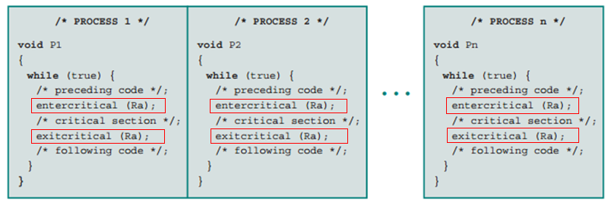
Mutual Exclusion
The bank account example demonstrated the importance of restricting access to critical sections of instructions.
OS provides mechanisms that are used by developers to create regions of Mutual Exclusion (Critical Sections) their code.

Slide 14
Requirements for a Mutual Exclusion Mechanism
Only one thread at a time is allowed into a critical section shared by multiple processes / threads.
A thread that blocks or exits outside of a critical section must not interfere with the execution of other threads.
A thread waiting to enter a critical section must not be delayed indefinitely i.e. no starvation.
When no thread is in a critical section, any thread wishing to enter the critical section will be allowed in without delay.
No assumptions can be made about the scheduling, execution speed, or number of threads accessing a critical section, etc.
A thread remains in a critical section for a finite amount of time. If a process dies, all the CS owned by its threads are released.
Notes:
One implication of these requirements is that if a thread exits (dies) in a critical section, the critical section is released allowing for a new waiting process to enter the critical section.

Slide 15
Mutual Exclusion: Hardware Support
How to implement a mechanism that allows for the mutual exclusive access of a single thread to a critical section?
The mechanism must be reliable in the face of hardware interrupts from timers and I/O devices.
The mechanism must work correctly on multiprocessors.
Notes:
1. The multiprocessor provides multiple parallel threads allowing for race conditions based on the parallel access of the shared data.

Slide 16
compare_and_swap Processor Instruction
Processors provide comparison instructions that execute in a single, uninterruptable instruction cycle.
This instruction allows a process to test and update the value in a memory location in a single, uninterruptable instruction cycle.
‘compare_and_swap’ pseudo code:
int compAndSwap(int *shared_word, int empty_val, int occup_val)
{
int val = *shared_word;
if(val == empty_val) *shared_word = occup_val;
return val;
}
Why is it important that the argument ‘shared_word’ be passed by reference?
Notes:
The three statements in this pseudo code execute in a single uninterruptable instruction cycle.
Note this scheme only works on a single processor (single core) microprocessor.
Intel provides the CMPXCHG8B instruction (among others).

Slide 17
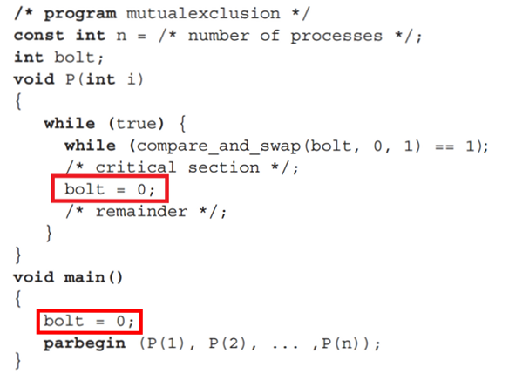
Implementing ME with the C&S Instruction
Release the Critical Section
Initialize the shared integer
The program must set bolt=0 when leaving the critical section.
Notes:
Note that the memory location ‘bolt’ is shared by all processes / processors.
Note the C&S instruction is in an empty while loop.
The critical section is defined between the empty while loop and the bolt=0 statements.
The program must set bolt=0 when leaving the critical section.

Slide 18
Disadvantage of the C&S Instruction
It utilizes spin-waiting i.e. blocked processes spend their RUNNING time repeatedly testing the shared word.
There is no mechanism to avoid either starvation or deadlock among waiting processes i.e. the process / thread that gains access to the critical section is non-deterministic.
For example, if the process dies while in the critical section, the waiting processes will never unblock.
Notes:
Why is this mechanism called a “Spin Lock”?

Slide 19
Semaphores
Semaphores are an OS Object that implements mutual exclusion in a more useful fashion than C&S instructions.
A service invoked by syscalls by threads wishing to obtain mutual exclusive access to a shared resource.
Semaphores implement mutual exclusion with two syscalls:
semWait(sem): Blocks execution of the calling thread if the semaphore is not available i.e. is held by a different thread.
semSignal(sem): Signals one of the waiting threads (if any) to resume execution.
The OS provides syscalls that allow the process to create and manipulate (wait, signal) semaphores.
Notes:
Semaphore is an object managed by the OS much like files, sockets, etc.

Slide 20
Using a Semaphore to Implement Mutual Exclusion
static Semaphore s = new Semaphore;
void run() {
while true: {
/* Pre Critical Section */
semWait(s);
/* Critical Section Here */
semSignal(s);
/* Post Critical Section */
}
}
void main() {
for i = 1 to 10:
threadStart(run);
}

Slide 21
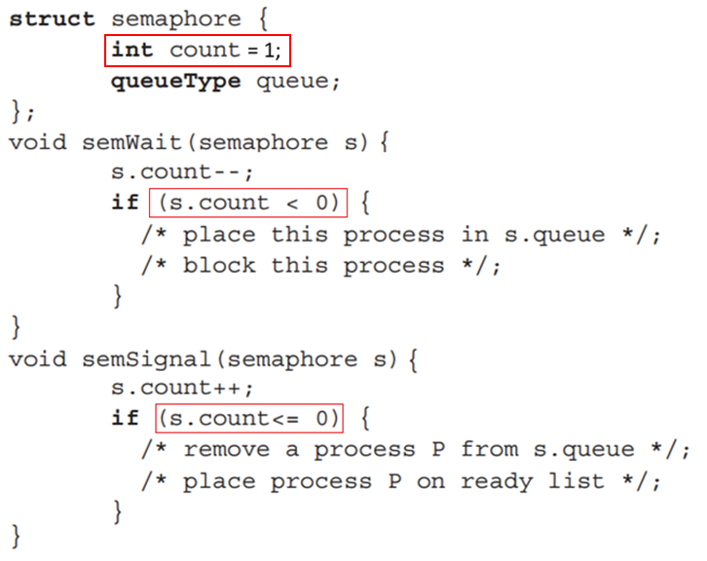
Semaphore Pseudocode
Notes:
This represent the implementation of the Semaphore by the Operating System Kernel.
Each semaphore maintains an individual FIFO queue of the processes / treads that are blocked waiting their turn.
Setting S = 1 causes the first thread to enter the critical section.

Slide 22
Semaphores Offer These Advantages
Threads waiting for the critical section are blocked eliminating the spin-waiting loop imposed by C&S instructions.
Fair scheduling of blocked threads using FIFO queue of treads waiting on the semaphore.
If the owning thread is terminated, the OS will release any held semaphores allowing waiting threads to continue execution.

Slide 23
Semaphores in Linux
Linux provides the following calls in support of creating and using semaphores.
See Example: http://www.amparo.net/ce155/sem-ex.html
sem_init( sem_t *sem, int pshared, int value);
Initializes the given semaphore to the given value.
phsared is a flag indicating a inter or intra process semaphore ¹.
sem_wait( sem_t* sem);
Tries to acquire the given semaphore and blocks if contended.
sem_post( sem_t* sem);
Releases the given semaphore and unblocks a waiting process / thread.
sem_trywait(sem_t*);
Tries to acquire the given semaphore and returns -1 if contended
Notes:
1) A semaphore that is to be used to coordinate inter process (between separate processes) must be allocated in a shared memory region.
sem_timedwait(sem_t *sem, const struct timespec *abs_timeout);
Tries to acquire the given semaphore and will wait the specified length of time if contended.

Slide 24
Semaphores in Java
The package java.util.concurrent provides the class Semaphore.
This class implements a counting semaphore mechanism.
Semaphore provides these methods (and many more):
Semaphore(int count): Constructor that initializes a new semaphore with the given count.
acquire(): Attempts to acquire the semaphore blocking the thread if contended.
release(): Releases the semaphore allowing a blocked thread to resume (if any).
Notes:
See the example code CriticalSectionSemaphore.java for an example of applying Java’s Semaphore.

Slide 25
Semaphore Fun Facts
The semaphore’s count is normally initialized to 1 allowing one process to pass semWait and enter the critical section.
But, count can be initialized to any value ≥ 1 allowing N processes to simultaneously enter the critical section before blocking begins.
The semaphore’s negative count indicates the number of processes waiting on the semaphore i.e. in its queue.
Count = 0 indicates the CS is occupied & no threads are waiting.
A semaphore that enforces FIFO is a Strong Semaphore.
If it does not enforce ordering is a Weak Semaphore.

Slide 26
Producer / Consumer with Fixed Length Queues
This is an example of two processes / threads that cooperate accessing a shared buffer of N ‘items’.
Producer: A thread that produces an item and places the item into the shared queue of fixed size.
Consumer: A thread that retrieves an item from the shared queue and acts on (consumes) it.
Coordination between threads is needed to ensure:
A producer can not place an item into a full queue.
A consumer can not retrieve an item from an empty queue.

Slide 27
A Fixed-Length Blocking FIFO Queue
A producer can not place an item into a full queue.
The producer’s thread attempting to put() an item into a full queue will block until an item is taken from the queue.
The producer’s thread will continue (unblock) when a different thread get()’s an item and queue space is freed.
A consumer thread attempting to get() an item from an empty queue will block until an item is placed into the queue.
The consumer’s thread will continue (unblock) when an item has been put() into the queue by a different thread.
The queue supports multiple producers and/or consumers.

Slide 28
Monitor Objects
The Monitor is an object designed to be accessed by multiple threads in a mutually exclusive (safe) fashion.
The methods of a monitor object will enforce mutual exclusion; at any time only one thread can be executing in an object’s method.
If a thread is currently executing a monitor object’s method, any other thread that calls a method of that object will have to wait until the first has finished.
In Java, monitor objects are the created by using the synchronized keyword when declaring a method.
In Linux, monitors are built with semaphores or other mutual exclusion mechanisms provided by the OS.
Notes:
In Linux, monitors are implemented with an OS primitive such as C&S Instructions or Semaphores.
Note that the meaning of the term monitor depends on its context. In Java, a monitor is the name given to the primitive lock associated with every object and is supported by the class Object’s wait() and notify() methods. In the text a monitor is an object whose method bodies define critical section boundaries and only one thread is allowed to execute a monitor’s methods. In Java, this type of monitor objects can be easily built by declaring the method synchronized.

Slide 29
Monitors in Java
In Java, monitors are built into the language so every object is a Monitor Object.
Java’s Object class implements a monitor’s capabilities.
These methods are used to manipulate the object’s monitor:
Object.wait() causes the calling thread to wait (block) for notify() to be called on the same object. Note: The calling thread always blocks.
Object.notify() releases a thread that is blocked by a wait() on the same object.
Object.notifyAll() releases all threads blocked by a wait on the same object.
Notes:
See code examples in ‘criticalSectionExamples.zip’ in the Sample Code eLearning folder.
The wait() method always blocks and places it self in a queue associated with the object whose wait method was called.
The notify() method will activate one of the threads blocked on the same object whose notify method was called.
The notifyAll() method will activate all blocked threads.

Slide 30
Building Critical Sections with Java Monitors
The methods of implementing critical sections in Java.
Synchronized Methods: The class may declare its methods ‘synchronized’. Only a single thread may execute a synchronized method.
Synchronized Blocks: The synchronized keyword can be used to declare a block a critical section. Only a single thread may enter a synchronized block.
Wait() and Notify() Methods: An object can be used to explicitly serialize multiple threads through a section of code.
In all the above, a single object must be shared by all of the threads that are cooperating / accessing the critical section.
Notes:
See the example code CriticalSectionMonitor.java for an example of building a critical section with Java’s monitors.

Slide 31
Blocking Finite Queue put()
// Two Monitors
Object notfull = new Object();
Object notempty = new Object();
String buffer[] = new String[MaxSize];
int count = 0;
void put(String str) {
if (count > MaxSize) {
notfull.wait();
}
// Critical Section
buffer[nextin] = str;
nextin = (nextin + 1) % MaxSize;
count++;
notempty.notify();
return;
// End Critical Section
}

Slide 32
Blocking Finite Queue get()
String get() {
if (count < 1) {
notempty.wait();
}
// Critical Section
String result = buffer[nextout];
nextout = (nextout + 1) % MaxSize;
count--;
notfull.notify();
return result;
// End Critical Section
}

Slide 33
Code Examples of Synchronization in Java
The eLearning folder “Sample Synchronized Code” contains code examples of Java’s synchronization primitives.
CriticalSectionMonitor.java for an example of creating a critical section using Java monitors.
CriticalSectionSynchronizedBlock.java uses the synchronized keyword to sync on a global object.
CriticalSectionSemaphore.java uses Java’s Semaphore class to implement the critical section.

Slide 34
Designing Thread-Safe Systems
Using threads is a tradeoff between performance and safety.
Lock nothing to get maximum performance from SMP, but risk errors due to race condition.
Lock everything eliminates race conditions but … 1) Increase the possibility of deadlock. 2) Eliminate the performance increases of parallel (SMP) execution.
The designer must consider the requirements of the application to make the trade-off between safety and performance.
Banking vs Ecommerce Site.

